Slide 1
Media Control Profile(MCP) Introduction
Chunhao Jiang, CSPD
Jen, 2024

Slide 2
Agenda
Concepts
Media Control Client procedures
Media Control Client receipt of notifications
Notes:
这是说

Slide 3
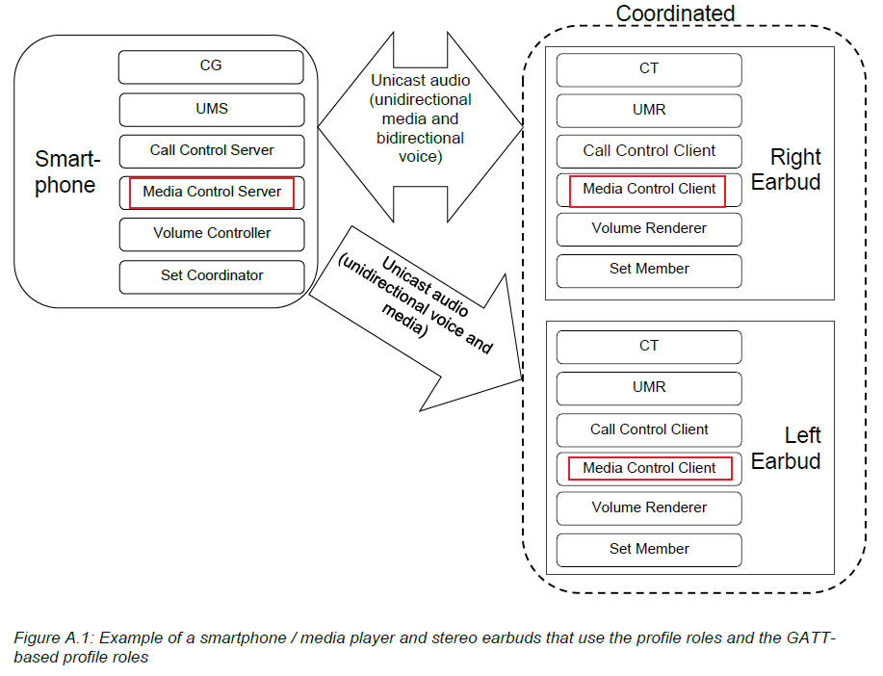
Concepts

Slide 4
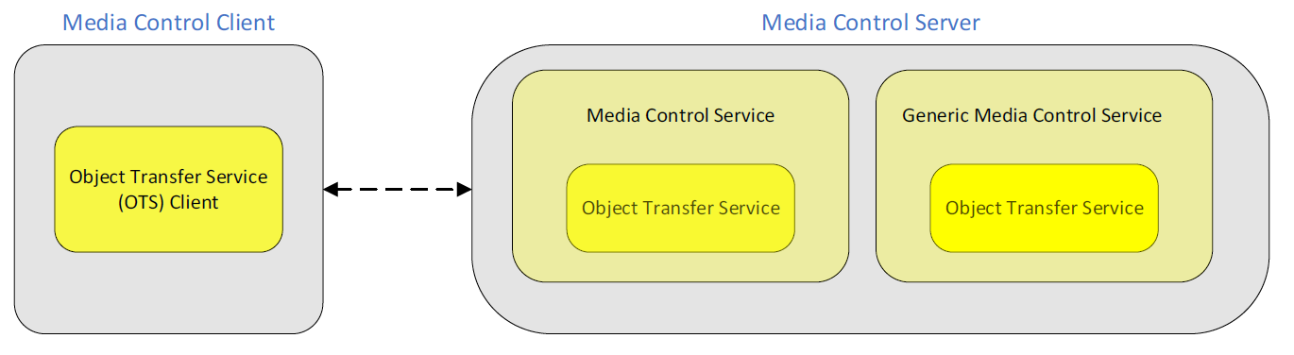
Concepts
Media Control Client: initiates playing and pausing, determines playing order, and collects search results from the Media Control Server.
Media Control Server: manage media tracks and conveys the various states and settings to the Media Control Client.
Object Transfer Service: Secondary Service, shall be included from the instance of the MCS or GMCS that it is associated with.

Slide 5
Media Control Client procedures
Procedure | function | Propority | Notes
Read Media Information | Discover the media player information | Read/Notify | Read the characteristic value of the Media Player Name characteristic can be set notification.
Read Media Player Icon Object Information | discover the media player icon as an object | Read | Such as “play”, “pause”, ”stop”, ”next”
Read Track Title | Discover the current track information | Read/Notify
Read Track Duration | discover the current track duration | Read
Read Track Position | discover the current track position | Read/Notify | Track Position characteristic is not notified to the client when the Track Position is changing because of playing the track.
Set Absolute Track Position | set the current track position on a Media Control Server to an absolute position. | Write
Set Relative Track Position | set the current track position on a Media Control Server to a position relative to the current track position. | Write/Notify | using the Move Relative opcode and the parameter set to the relative time of the move.

Slide 6
Media Control Client procedures
Procedure | function | Propority | Notes
Read Playback Speed | discover the current playback speed of the current track | Read
Set Playback Speed | set the playback speed of the current track | Write
Read Seeking Speed | discover the current track seeking speed | Read
Read Current Track Segments Object Information | discover the track segments as an object in the included Object Transfer Service. | Read | Characteristic value can be used as an Object ID in the included OTS to obtain the track segments information.
Read Current Track Object Information | discover the current track as an object in the included Object Transfer Service | Read
Set Current Track Object ID | set the current track on a Media Control Server to a track identified by an Object ID. | Write
Read Next Track Object Information | discover the next track as an object in the included Object Transfer Service. | Read
Set Next Track Object ID | set the next track on a Media Control Server to a track identified by an Object ID | Write

Slide 7
Media Control Client procedures
Procedure | function | Propority | Notes
Track Discovery – Discover by Current Group Object ID | discover the tracks that are part of the current group object. | Read | Each Object Record in the group object is a track or sub-group that is contained within the group.
Set Current Group Object ID | set the current group on a MCS to a group identified by an Object ID. | Read
Read Parent Group Object Information | discover the parent group as an object in the included Object Transfer Service. | Read
Read Playing Order | discover the playing order on a MCS | Read
Set Playing Order | control the playing order on a MCS | Read | MCC should write a characteristic that server support
Read Playing Order Supported | the different playing orders supported on a Media Control Server. | Read
Read Media State | discover the Media State | Read/Notify

Slide 8
Media Control Client procedures
Procedure | function | Propority | Notes
Play Current Track | start playing the current track | write | write the Play opcode
Pause Current Track | pause the playing of the current track | write | write the Pause opcode
Fast Forward Fast Rewind | fast forward or fast rewind the current track | write | write the Fast Forward opcode or the Fast Rewind opcode
Move to Previous Segment | move to the previous segment within the current track | write | write the Previous Segment opcode
Move to Next Segment | move to the next segment within the current track | write | write the Next Segment opcode
Move to First Segment | move to the first segment within the current track | write | write the First Segment opcode
Move to Last Segment | move to the last segment within the current track | write | write the Last Segment opcode
Move to Segment Number | move to the nth segment within the current track | write | write the Goto Segment opcode with the parameter

Slide 9
Media Control Client procedures
Procedure | function | Propority | Notes
Move to Previous Track | move to the previous track | write | write the Previous Track opcode
Move to Next Track | move to the next track | Write/notify | Track Title, Current Track Object ID, Next Track Object ID, Track Duration, and Track Position characteristics after change
Move to First Track | move to the first track within the current group | write | write the First Track opcode
Move to Last Track | move to the last track within the current group | write | write the Last Track opcode
Move to Track Number | move to the nth track within the current group | write | write the Goto Track opcode with the parameter
Move to Previous Group | move to the previous group | write | write the Previous Group opcode

Slide 10
Media Control Client procedures
Procedure | function | Propority | Notes
Move to Next Group | move to the next group | write | write the Next Group opcode
Move to First Group | move to the first group | write | write the First Group opcode
Move to Last Group | move to the last group | write | write the Last Group opcode
Move to Group Number | move to the nth group | write | write the Goto Group opcode with the parameter
Read Media Control Point Opcodes Supported | discover the Media Control Point opcodes supported by the Media Control Server | Read/write
Search | perform a search of all the media | Write/read/notify
Read Content Control ID | read the CCID to identify an instance of the Media Control Service | Read

Slide 11
Media Control Client receipt of notifications
Track Changed notification
Media Control Point notification
Search Control Point notification
Object Changed indication

Slide 12
Thank you for listening!

